Slide 1


Governmental Economical Policy towards Arab Sector
The Authority for Economic Development of the
Minorities Sector
Aiman Saif
November 2014

Slide 2
General Demographics
Source: Central Bureau of Statistics, 2013

Slide 3
Minorities By Religion

Slide 4
Geographic Distribution
Source: Central Bureau of Statistics, 2013

Slide 5
Geographic Distribution
Source: Central Bureau of Statistics, 2013

Slide 6
Natural Growth Rates
2059 Forecast: Arabs will make up 23% of the population
Source: Central Bureau of Statistics, 2013

Slide 7
Poverty Data
Source: Central Bureau of Statistics

Slide 8
Poverty Incidence among families by sector and number of breadwinners
Poverty Incidence and Number of Breadwinners
Data Processing: National Economic council , 2012

Slide 9
Average study years
Minorities Academics
Ministry of Economy, 2013
Notes:
Arab Youth
In 2009 - About 40% of Arab youth (Ages 18-22) did not study or work, 25.6% of the men and 52.1% of the women.
28.9% Arab women has 0-8 years of education compared with 4.5% of the Jewish women

Slide 10
Workforce participation rates in Israel ages 18-66 ,1980- 2012
Ministry of Economy, 2013
Notes:
Arab men: dropped by around 10 %
Arab women: rose significantly (more than doubled) but still very low
Jewish men: remained steady
Jewish women: rose significantly

Slide 11
Net Impact of Demography on
Employment Rates (ages 25-64)*
%
ממוצע OECD בשנת 2011
*Under the assumption that Employment Rates remain constant for each age, gender & sector group
CBS data processed by Bank of Israel
Notes:
Israeli workforce is shrinking, according to Demographic Forecast
The big Challenge: Preserving work force rates by Increasing workforce rates in under participating groups, there lies the potential.
One point increase in employment rate contributes over 10 billion NIS to the GNP

Slide 12
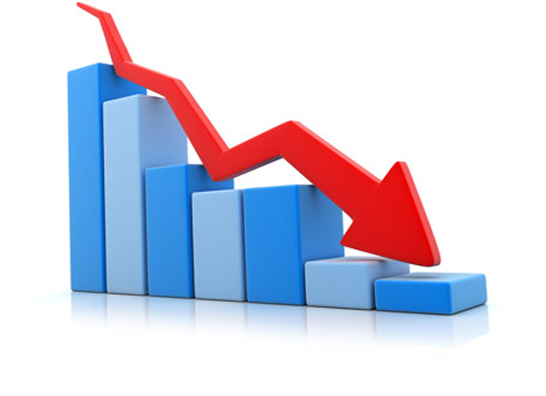
Lost Potential
Arab citizens, despite constituting more than 20% of the population, contribute only 8% to Israel’s GDP at an estimated loss of
over 30 billion NIS each year
Notes:
In addition to low standards of
living and difficult conditions on individual and community levels, high rates of poverty mean
high costs to the country in state welfare services, lost productivity, lost tax revenue, and low
consumer activity

Slide 13
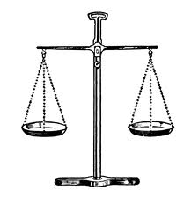
Equal Citizens?
By law: Equal rights – Equal services
In Practice: Underserved population
large socio-economic gaps
Governmental policy for economic integration of minorities
  Establishing the Authority for Economic Development
  Designated programs (total budget: 4 billion NIS)
Notes:
Equal rights
Equal Services: Health, Education, welfare…
As a result of unique characteristics of Arab Minority along with the structural discrimination and limited access to government services, the quality of services is much lower among Arab citizens and large socio-economic gaps were created.
In addition to regular government services, special attention and investment in the Arab population in order to reduce these gaps: Establishing the Authority For Economic Development
designated programs (Total Budget: 4 billion NIS)

Slide 14
The Authority for Economic Development of the Minorities Sector
Mission:
Developing and integrating the Arab population in the Israeli Economy

Slide 15
Main Areas of Activity
Empowering municipalities
Upgrading Business sector
Encouraging Employment
HR Development & Accessibility to higher education

Slide 16
Encouraging Employment and HR Development – Model
Supply
Job Seekers
Demand
Employers
Local Economic Infrastructures

Slide 17
HR Development
Accessibility to Higher Education
Supply
Job Seekers
Vocational Training Programs
Women Entrepreneurships

Slide 18

Arab Scholarship Program
Government and Philanthropy
Working Together
650 Scholarships in 2014
Purpose: Raising the rate of Arab student for first degree
Based on socio-economic criteria and preferred fields of study
Notes:
Pears Foundation
UJA Federation of NewYork
Mandell and Medeliene Berman Foundation
Jacob and Hilda
Council for Higher Education

Slide 19
Job Opportunities – Major Challenge
Employment Subsidy
Demand
Employers
Job Placement – Private Sector
Advertising Campaign
Government Sector

Slide 20
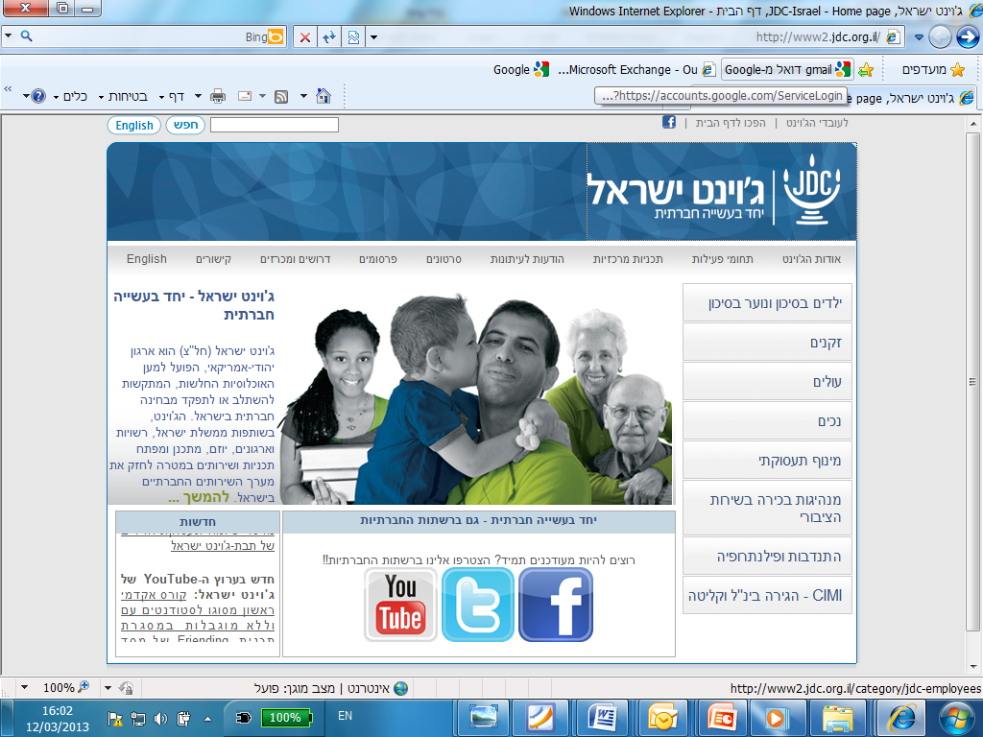
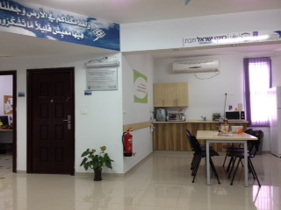
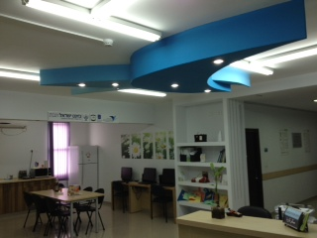
Government and Philanthropy Working Together
Local Economic Infrastructures
21 Employment Centers
Employment Center in Tira

Slide 21
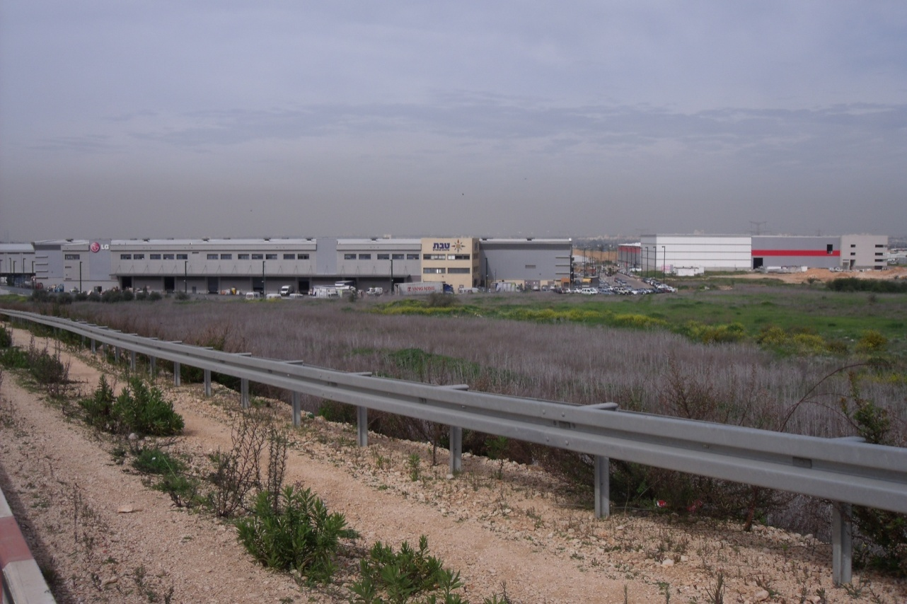
Local Economic Infrastructures
Industrial Zones
Industrial Zones Development: 3000 Dunams
Industrial Zones Planning: 1920 Dunams
Total Investment : 230 Mil NIS
Kfar Kassem – Industrial area – Lev Haaretz - 600 dunams

Slide 22
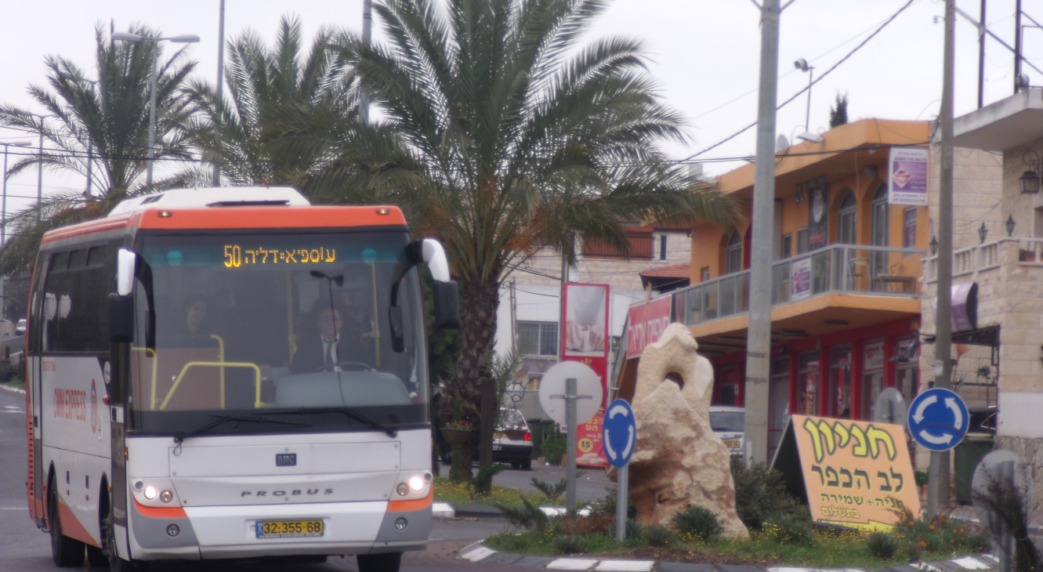
Local Economic Infrastructures
Public Transportation
2013: About 200,000 bus passengers weekly
compared to 33,000 at 2010
(580% growth)

Slide 23
Encouraging Employment and HR Development
Supply
Job Seekers
Demand
Employers
Local Economic Infrastructures

Slide 24
נגישות לאשראי, שווקים וידע
חיזוק המגזר העסקי
Upgrading the Business Sector
Access to Capital
Private Equity Fund
Governmental & Micro Finance loans
Access to Market
Export Encouragement
Access to know How
Business Incubators
Entrepreneurship &
Technological Innovation
Business and Government Procurement

Slide 25

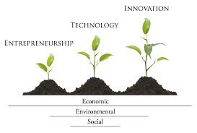
Entrepreneurship & Technological Innovation
Technological Incubators
Chief Scientist Track (85% subsidy)
Business Acceleration Programs

Slide 26


Future Plans
Holistic Economic Development Program for Arab Communities
Upgrading Arab Education System
Notes:
Challenges:
As a result of recent events (zuk eitan) and because of budget constraints there is a change in government priority
Summary
Positive Trends in socio-economic Indicators
Gaps remain large
Government Priority, Designated budgets
Philanthropy is leveraging government funds

Slide 27
THANKS!

